Slide 1
CONTAINER TRANSPORTATION COMPANY
Group- 6

Slide 2
GOAL
Optimize the profit and revenue for the Container Transportation Company
Find optimal containers of type 20’ and 40’ to maximize the revenue
Explore dynamic pricing to enhance the revenue

Slide 3
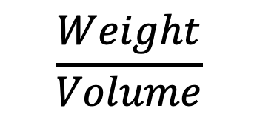
What makes for container “loadability” and how should CTC include loadability” factor into its pricing decisions?
$$\frac{Weight}{Volume}$$
ratio makes for the container loadability.

Slide 4

CONSTRAINTS
Optimal number of containers for 20’ and 40’ to maximize revenue
• Demand: Sum of TEU of each container types should not
exceed demand at each port.
• Volume: Sum of the volume of each container type loaded
on vessel should not exceed 1900 TEU
• Weight: Sum of the weight of each container type loaded
on vessel should not exceed 22800 tons
• Ratio: Ratio of 20 TEU/40 TEU should be between 1.2 and 2
• Standard Non-negativity Constraints.

Slide 5
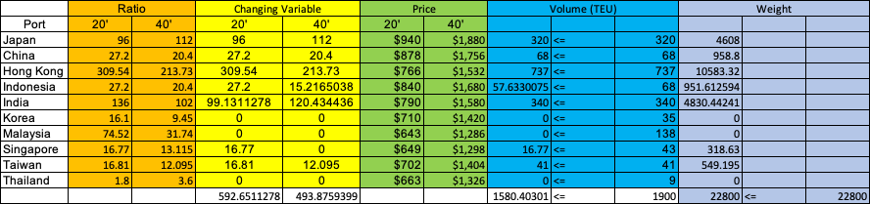

HIGH DEMAND
Max Revenue: $1,281,723

Slide 6
LOW DEMAND
Max Revenue: $1,257,351

Slide 7
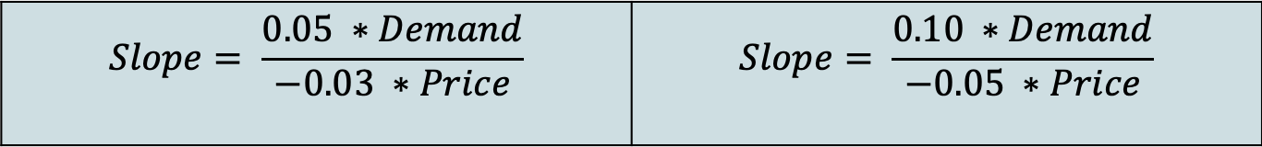
How might demand curves be derived from Thomas’ price/volume estimates?
High Demand
Low Demand
$$Slope= \frac{0.05 ∗Demand}{−0.03 ∗Price}$$ | $$Slope= \frac{0.10 ∗Demand}{−0.05 ∗Price}$$
Intercept = Demand – Slope * Price
Using Demand as a function of Price:
Demand = Slope * Price + Intercept

Slide 8
HIGH DEMAND
Max Revenue: $1,322,055

Slide 9
HIGH DEMAND

Slide 10
LOW DEMAND
Max Revenue: $1,253,421

Slide 11
LOW DEMAND

Slide 12
What might be the next step for CTC if it decides to do further work on implementing Revenue Management?
Include loadability factor in pricing decisions
Should not focus on the Fixed Costs

